Slide 1

Time Series Forecasting of User Engagement in Python Software Applications Based on Usage Logs
Janarthan Vijayakumar
vjanarthan@std.appsc.sab.ac.lk
19APSE4276
Supervisor: Mrs. JDT Erandi
Lecturer (Probationary),
Dept of Data Science,
Faculty of Computing,
Sabaragamuwa University of Sri Lanka
DEPARTMENT OF SOFTWARE ENGINEERING
SE 8101 - RESEARCH PROJECT IN SE

Slide 2
CONTENTS
  Background
  Literature Review
  Research Gap
  Significance of the Research
  Problem Statement & Research Questions
  Research Objectives & Goals
  Proposed Research Method/s
  Expected Outcome/s
  References
DEPARTMENT OF SOFTWARE ENGINEERING
SE 8101 - RESEARCH PROJECT IN SE

Slide 3
  background
User engagement is a key concern in Python software projects.
Developers want to understand how users interact with features.
Usage logs record valuable data: timestamps, session duration, errors.
Most systems only provide past insights, not future predictions.
Python tools like data science libraries show irregular usage (e.g., exam season spikes).
Traditional models like regression often fail to capture time-based patterns.
Time series models (e.g., ARIMA, LSTM) can detect trends and forecast behavior.
This research focuses on predicting engagement using Python-based logs.
ARIMA (Autoregressive Integrated Moving Average) and LSTM (Long Short-Term Memory)
DEPARTMENT OF SOFTWARE ENGINEERING
1
SE 8101 - RESEARCH PROJECT IN SE

Slide 4
  LITERATURE REVIEW
Early studies used statistical models like ARIMA to capture engagement trends.
ARIMA is effective for linear patterns but fails with complex behavior.
LSTM (deep learning) handles nonlinear and long-term user behavior better.
Hybrid models like Prophet-LSTM improve accuracy by combining both methods.
Python ecosystem (Prophet, TensorFlow, FastAPI) supports full forecasting pipelines.
Most research focuses on mobile apps or social platforms, not Python tools.
Few studies address bursty, irregular usage in developer-focused apps.
DEPARTMENT OF SOFTWARE ENGINEERING
2
SE 8101 - RESEARCH PROJECT IN SE

Slide 5
  LITERATURE REVIEW
Ref No. | Researcher(s) | Objective | Methodology (incl. dataset/tools) | Limitations
[1] | Liu et al. (2019) | Forecast user engagement using in-app action graphs (Snapchat) | Action graphs; real-time activity modeling; Snapchat data | Focused on social media, not developer or Python-based tools
[2] | Kong et al. (2021) | Hybrid forecasting using Prophet and LSTM | Prophet for seasonal trend + LSTM for residuals; real-world time series data | Lacks application in domain-specific Python tools or irregular patterns
[3] | Liu & Wang (2024) | Survey of deep learning in time series forecasting | Overview of LSTM, GRU, Transformer use in TSF | Generalized survey — no focus on engagement or Python apps
[4] | Jin et al. (2024) | Review of GNNs in time series | Survey; categorized use cases of GNNs | GNNs require large, structured data — not ideal for small-scale Python logs
[5] | Stromer et al. (2024) | Design forecasting tools for non-experts | Human-readable forecasting systems; model explainability | High-level framework; lacks technical focus on engagement prediction
[6] | Tang et al. (2020) | User engagement prediction on social apps (FATE Framework) | Friendship + user actions + temporal explanations using GNNs and LSTMs | Built for social networks; not applicable for batch-based Python usage logs
Figure 1 : Literature Review
DEPARTMENT OF SOFTWARE ENGINEERING
3
SE 8101 - RESEARCH PROJECT IN SE

Slide 6
  LITERATURE REVIEW
Ref No. | Researcher(s) | Objective | Methodology (incl. dataset/tools) | Limitations
[7] | Li et al. (2023) | Track intent changes on LinkedIn with DIGMN | Meta-learning model (DIGMN); long-term intent-based engagement tracking | Context-specific (LinkedIn); not adaptable to irregular small-scale Python logs
[8] | Gnanasekaran et al. (2023) | Forecast web traffic using Prophet | Prophet model with missing data handling and holidays | Web traffic focus; ignores Python app scenarios and engagement metrics
[9] | Seca (2021) | Debug forecasting pipelines using TimeGym | Tool for testing and evaluating time series models in Python | Not a model — just a testing framework; lacks forecasting architecture
[10] | Bollig et al. (2024) | Event-log forecasting for business processes | Streaming predictions using n-grams, LSTMs | Targets business workflows — not developer tools or sparse user engagement scenarios
Figure 2 : Literature Review
DEPARTMENT OF SOFTWARE ENGINEERING
4
SE 8101 - RESEARCH PROJECT IN SE

Slide 7
  Research Gap
Most existing studies focus on mobile, social, or web applications — not Python-based tools.
Engagement forecasting is rare in developer-focused or utility-based Python apps.
Traditional models (e.g., regression, ARIMA) fail with bursty or irregular usage patterns.
Deep learning models like LSTM are underused in software engineering engagement research.
No unified framework exists for engagement forecasting using Python app usage logs.
Lack of research on proactive user retention based on predictive temporal patterns in logs.
DEPARTMENT OF SOFTWARE ENGINEERING
5
SE 8101 - RESEARCH PROJECT IN SE

Slide 8
  Significance of the Research
Helps Python developers to predict user engagement trends in real-time.
Provides proactive decision-making support for feature planning and resource allocation.
Offers a forecasting framework tailored to Python usage logs — a first of its kind.
Enhances software quality, retention, and user satisfaction.
Supports open-source sustainability by forecasting contributor and user drop-off.
Bridges Software Engineering with Data Science through real-time analytics.
Contributes to modern trends in temporal analytics and smart software systems.
DEPARTMENT OF SOFTWARE ENGINEERING
6
SE 8101 - RESEARCH PROJECT IN SE

Slide 9
  Problem Statement & Research Questions
  Problem Statement
Forecasting user engagement in Python apps is limited by model and data constraints.
Traditional models like ARIMA miss complex user behavior.
Advanced models like LSTM/GNN need high-quality data and large resources.
Existing studies target mobile/social apps, not Python developer tools.
Irregular usage patterns (e.g., academic tools) aren't well supported.
A hybrid, interpretable forecasting model tailored for Python is needed.
GNN (Graph Neural Network)
DEPARTMENT OF SOFTWARE ENGINEERING
7
SE 8101 - RESEARCH PROJECT IN SE

Slide 10
  Problem Statement & Research Questions
  Research Questions
RQ1: How does ARIMA compare to other statistical models in predicting Python app engagement?
RQ2: Can LSTM or GNN outperform classical models with sparse log data?
RQ3: What are the best hybrid models (Prophet-LSTM, ARIMA-GRU) for irregular patterns?
RQ4: How do contextual events (holidays, updates) affect forecasting accuracy?
RQ5: What is the ideal design for a Python-native, batch-based forecasting tool?
DEPARTMENT OF SOFTWARE ENGINEERING
8
SE 8101 - RESEARCH PROJECT IN SE

Slide 11
  Research Objectives & Goals
  Main Objective
To develop a forecasting model that uses Python application usage logs to predict future user engagement, enabling developers to plan and improve user experience.
  Specific Objectives
RO1: Analyze the accuracy of ARIMA and other traditional time series models.
RO2: Evaluate how LSTM and GNN perform with evolving user behavior.
RO3: Build a hybrid model that combines traditional and ML-based forecasting for higher accuracy.
RO4: Improve forecasting by including internal/external events (e.g., updates, holidays).
RO5: Design a Python-native, automated forecasting system for developer use.
DEPARTMENT OF SOFTWARE ENGINEERING
9
SE 8101 - RESEARCH PROJECT IN SE

Slide 12
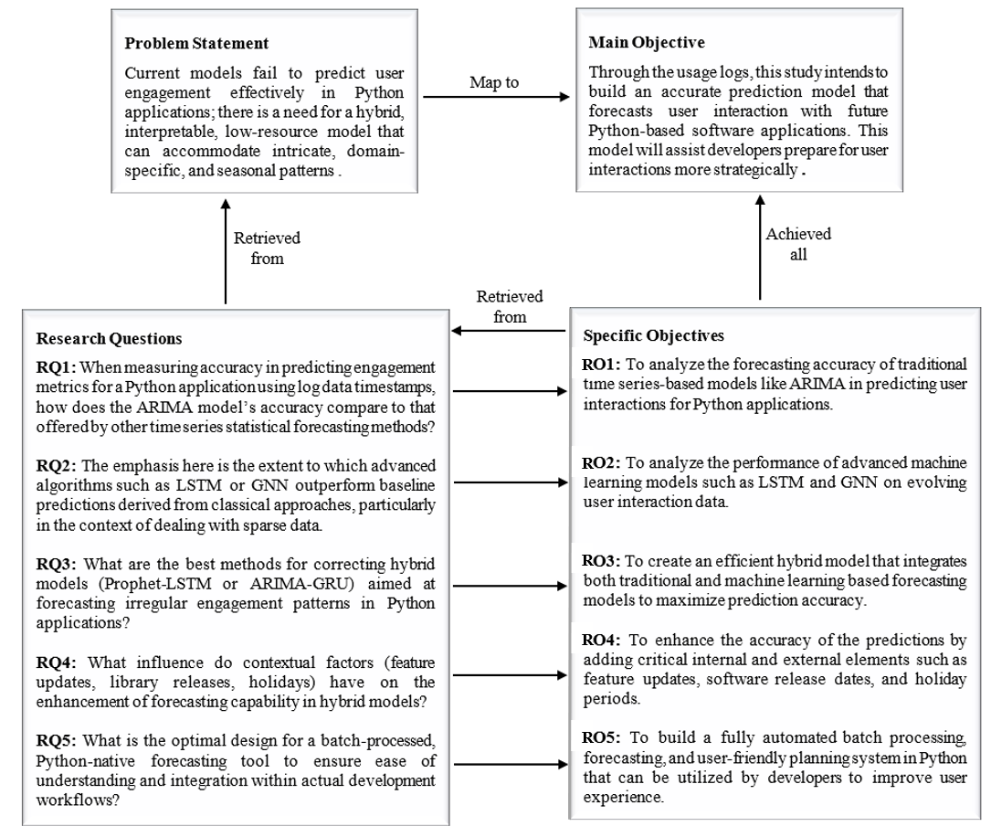
  Research Questions and Research Objectives mapping
Figure 3 : Research Questions and Research Objectives mapping
DEPARTMENT OF SOFTWARE ENGINEERING
10
SE 8101 - RESEARCH PROJECT IN SE

Slide 13
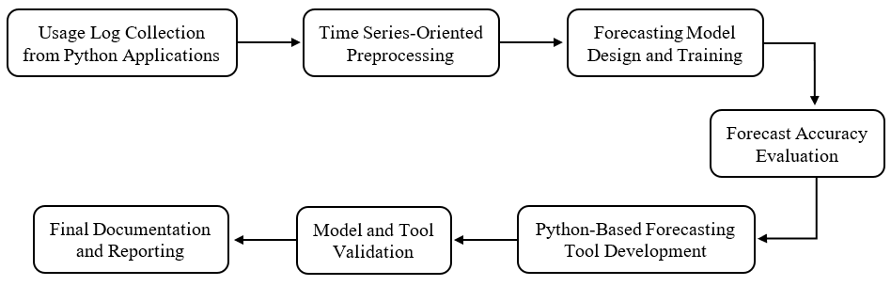
  Proposed Research Methods
Figure 4 : Proposed Research Methods
DEPARTMENT OF SOFTWARE ENGINEERING
10
SE 8101 - RESEARCH PROJECT IN SE

Slide 14
  Proposed Research Methods
Step | Description
1. Usage Log Collection | Collect real or simulated logs from Python apps (timestamps, sessions, feature usage) using tools like Faker and Locust if needed.
2. Time Series Preprocessing | Clean logs, handle missing data, remove outliers, aggregate into time intervals (e.g., DAU), and add contextual features (holidays, releases).
3. Model Design & Training | Build and compare three types of models: ARIMA (linear trends) LSTM/GRU (nonlinear, long-term patterns) Hybrid models (e.g., Prophet-LSTM, ARIMA-GRU).
4. Forecast Evaluation | Evaluate using accuracy metrics: MAE, RMSE, MAPE. Test performance under sparse and burst usage patterns.
Figure 5 : Proposed Research Methods – Explanation
GRU (Gated Recurrent Unit) and MAE (Mean Absolute Error) and
RMSE (Root Mean Squared Error) and MAPE (Mean Absolute Percentage Error)
DEPARTMENT OF SOFTWARE ENGINEERING
11
SE 8101 - RESEARCH PROJECT IN SE

Slide 15
  Proposed Research Methods
Step | Description
5. Tool Development | Build a Python-based forecasting tool using: FastAPI for REST API TensorFlow/Prophet for modeling Matplotlib/Seaborn for visualization.
6. Validation | Validate models via: Cross-validation Public datasets (e.g., GitHub logs) Developer feedback on tool usability and interpretability.
7. Documentation | Document models, preprocessing steps, results, and tool usage. Include diagrams, flowcharts, and forecast output examples.
Figure 6 : Proposed Research Methods – Explanation
DEPARTMENT OF SOFTWARE ENGINEERING
12
SE 8101 - RESEARCH PROJECT IN SE

Slide 16
  Expected Outcomes
A hybrid forecasting model tailored to predict engagement in Python applications.
Insights into how ARIMA, LSTM, and hybrid models perform on different usage patterns.
A Python-native forecasting tool with batch processing and visual reporting.
Improved decision-making support for Python developers based on engagement trends.
A validated system that works with real and simulated usage logs.
Contribution to software engineering research by focusing on developer-oriented tools.
A reusable forecasting framework for future open-source or educational tools.
DEPARTMENT OF SOFTWARE ENGINEERING
13
SE 8101 - RESEARCH PROJECT IN SE

Slide 17
  System Overview
  System Overview Statement
“The proposed system is a Python-based engagement forecasting framework that processes usage logs from software applications, applies time series models such as ARIMA, LSTM, and hybrid combinations, and outputs accurate predictions of user interaction trends. It is designed to help developers make proactive decisions by offering automated, visualized forecasts through a lightweight web interface.”
DEPARTMENT OF SOFTWARE ENGINEERING
13
SE 8101 - RESEARCH PROJECT IN SE

Slide 18
  References
[1] Y. Liu, X. Shi, L. Pierce, and X. Ren, "Characterizing and forecasting user engagement with in-app action graph: A case study of snapchat," in Proceedings of the 25th ACM SIGKDD international conference on knowledge discovery & data mining, 2019, pp. 2023-2031.
[2] K. Y. Hern, L. K. Yin, and C. W. Yoke, "Forecasting facebook user engagement using hybrid prophet and long short-term memory model," in International Conference on Digital Transformation and Applications (ICDXA), 2021, vol. 25, p. 26.
[3] X. Liu and W. Wang, "Deep Time Series Forecasting Models: A Comprehensive Survey," Mathematics, 2024.
[4] M. Jin et al., "A Survey on Graph Neural Networks for Time Series: Forecasting, Classification, Imputation, and Anomaly Detection," IEEE Transactions on Pattern Analysis and Machine Intelligence, vol. 46, no. 12, pp. 10466-10485, 2024, doi: 10.1109/TPAMI.2024.3443141.
[5] R. Stromer, O. Triebe, C. Zanocco, and R. Rajagopal, "Designing forecasting software for forecast users: Empowering non-experts to create and understand their own forecasts," ArXiv, vol. abs/2404.14575, 2024.
[6] X. Tang, Y. Liu, N. Shah, X. Shi, P. Mitra, and S. Wang, "Knowing your fate: Friendship, action and temporal explanations for user engagement prediction on social apps," in Proceedings of the 26th ACM SIGKDD international conference on knowledge discovery & data mining, 2020, pp. 2269-2279.
[7] F. Li et al., "DIGMN: Dynamic Intent Guided Meta Network for Differentiated User Engagement Forecasting in Online Professional Social Platforms," presented at the Proceedings of the Sixteenth ACM International Conference on Web Search and Data Mining, Singapore, Singapore, 2023. [Online]. Available: https://doi.org/10.1145/3539597.3570420.
[8] H. Gnanasekaran, D. P, and U. Köse, "Time-series Forecasting of Web Traffic Using Prophet Machine Learning Model," vol. 1, pp. 161-177, 11/29 2023.
[9] D. Seca, "TimeGym: Debugging for Time Series Modeling in Python," arXiv preprint arXiv:2105.01404, 2021.
[10] B. Bollig, M. Függer, and T. Nowak, A Framework for Streaming Event-Log Prediction in Business Processes. 2024.
DEPARTMENT OF SOFTWARE ENGINEERING
13
SE 8101 - RESEARCH PROJECT IN SE

Slide 19
Thank You

